Slide 1
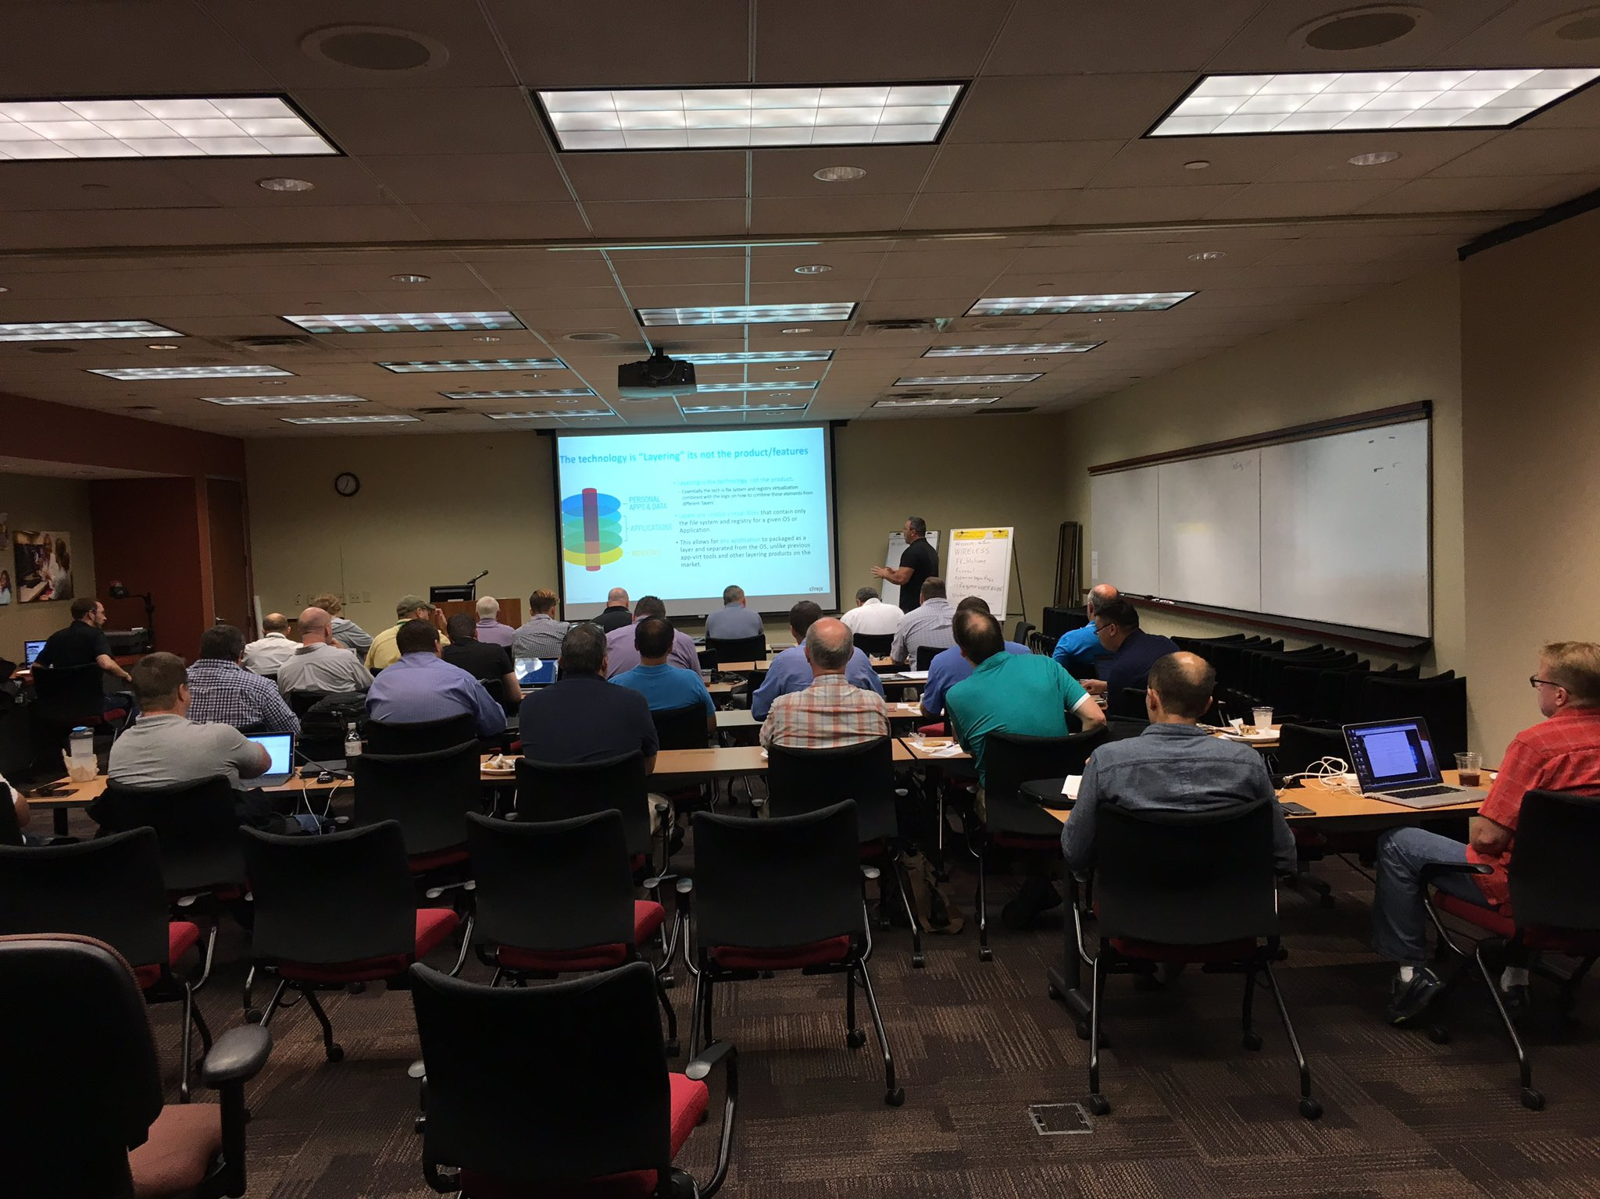

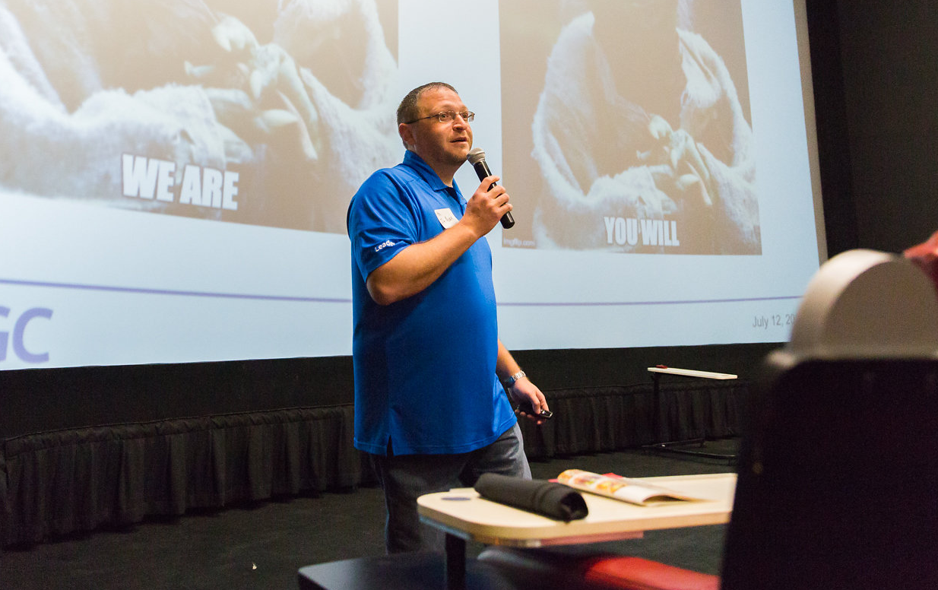
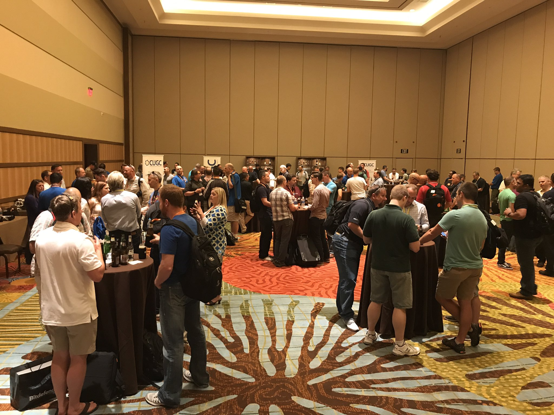
LEARN.
JOIN TODAY
SHARE.
WWW.MYCUGC.ORG
CONNECT.

Slide 2

EUC State of the Union 2020 2021 Edition

Slide 3




Before we get started:
You will receive a link to today’s recording.
Submit your questions in the chat anytime! We’ll take them at the end.
Please fill out our survey!
#myCUGC

Slide 4


Presenter:
Moderator:
Marius Sandbu
Guild Lead Public Cloud TietoEVRY
@msandbu
msandbu.org
Jake Walsh
Principal Consultant
CDW UK
@jakewalsh90
jakewalsh.co.uk
#myCUGC

Slide 5
So what happened last year in EUC? (and so far in 2021….) - Product rebranding - Logo Changes - Company acquisition (*ehem Wrike*) Disclaimer: Might not have gotten all the new cool announcements from Ignite in here yet...

Slide 6
Agenda
Ransomware and how this can be a problem from a VDI perspective?
Why all the fuzz with vendors and Zero-Trust?
SASE? Yet another acronym but something that is linked to Zero-Trust
Modern workplace and passwordless authentication and how this now works
Citrix Analytics vs Workspace ONE Intelligence
Latest EUC updates from Microsoft, Amazon and Google from a birds view
Latest VDI Updates from Citrix, Microsoft and VMware
Updates to Citrix Cloud & Windows Virtual Desktop
The ecosystem around WVD
Latest recap from Ignite
What does the future hold for EUC?

Slide 7
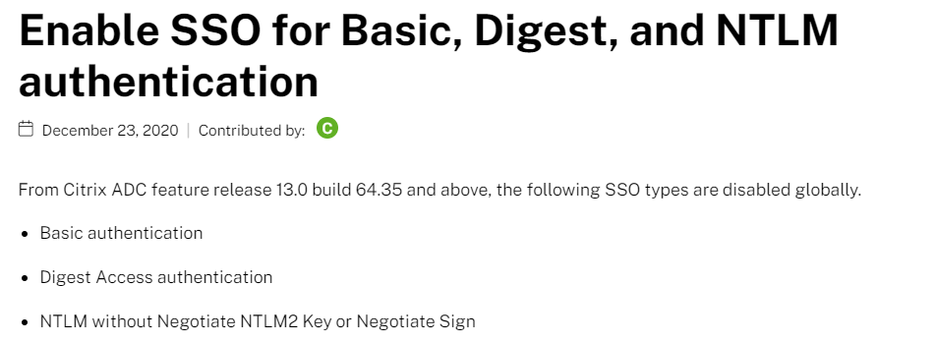
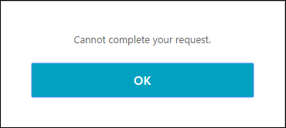
Also... while I remember it
Enable SSO for Basic, Digest, and NTLM authentication (citrix.com)

Slide 8
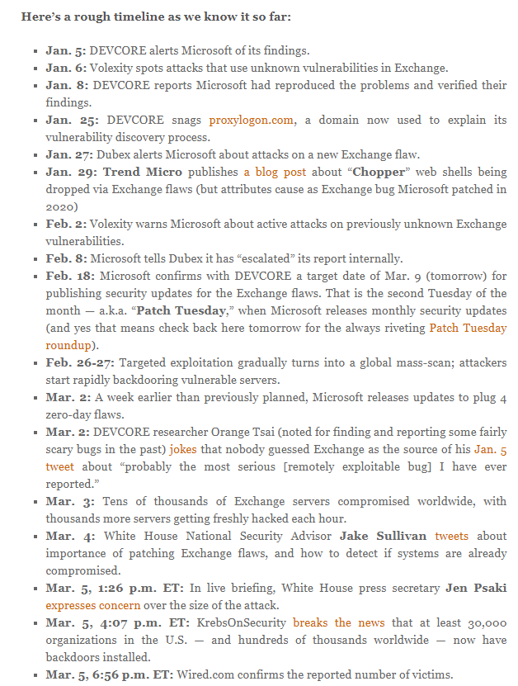
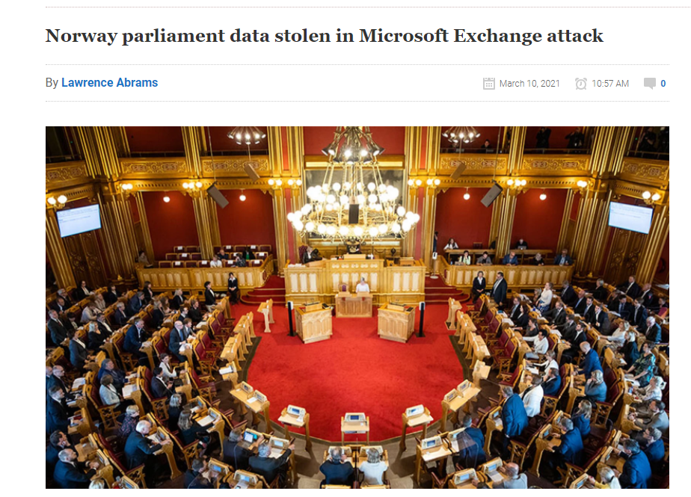
Also... while I remember it #2

Slide 9
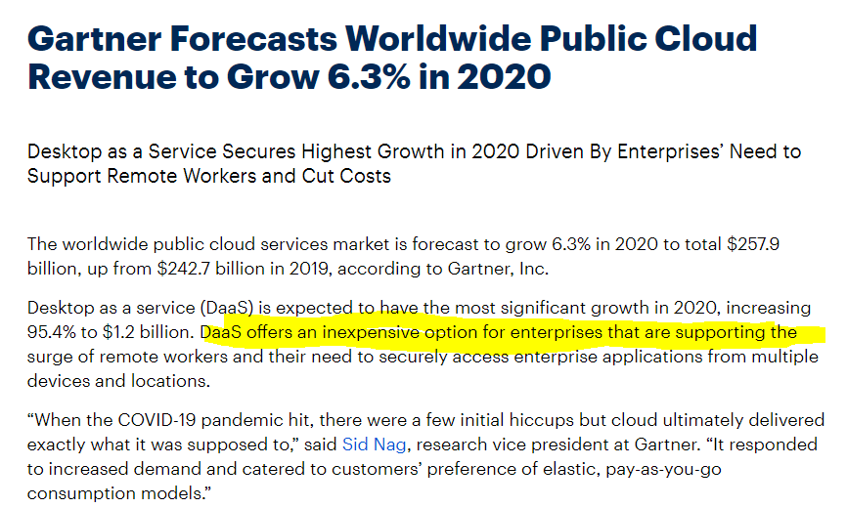
Clearly that more organizations will move to DaaS based delivery

Slide 10
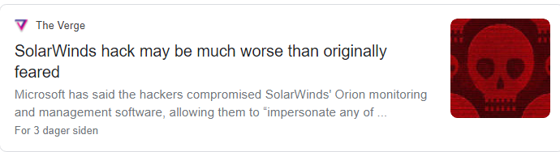
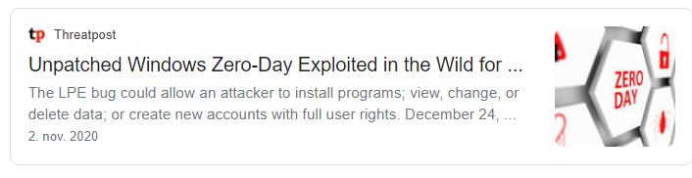
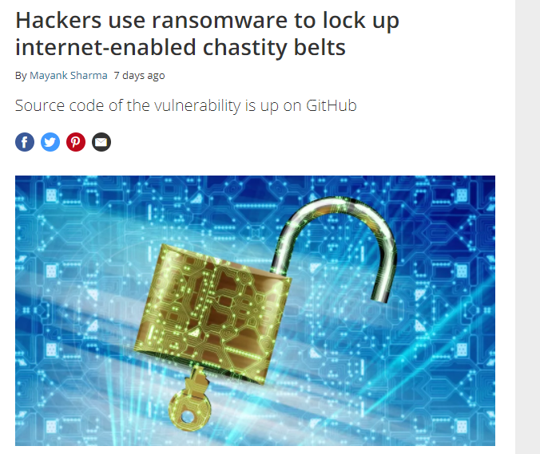
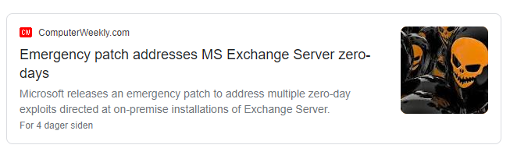
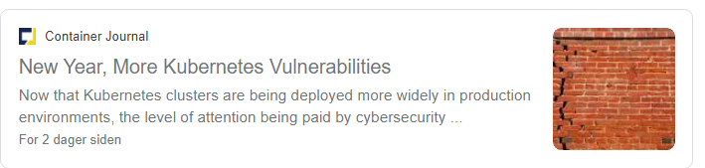
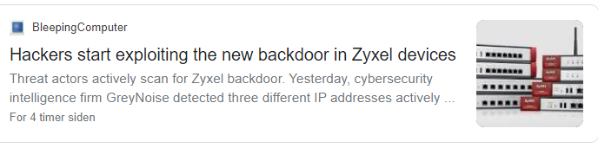
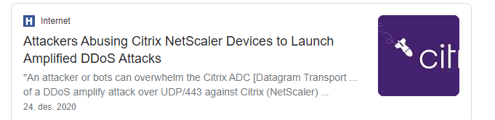
Still needs a lot of patching...

Slide 11
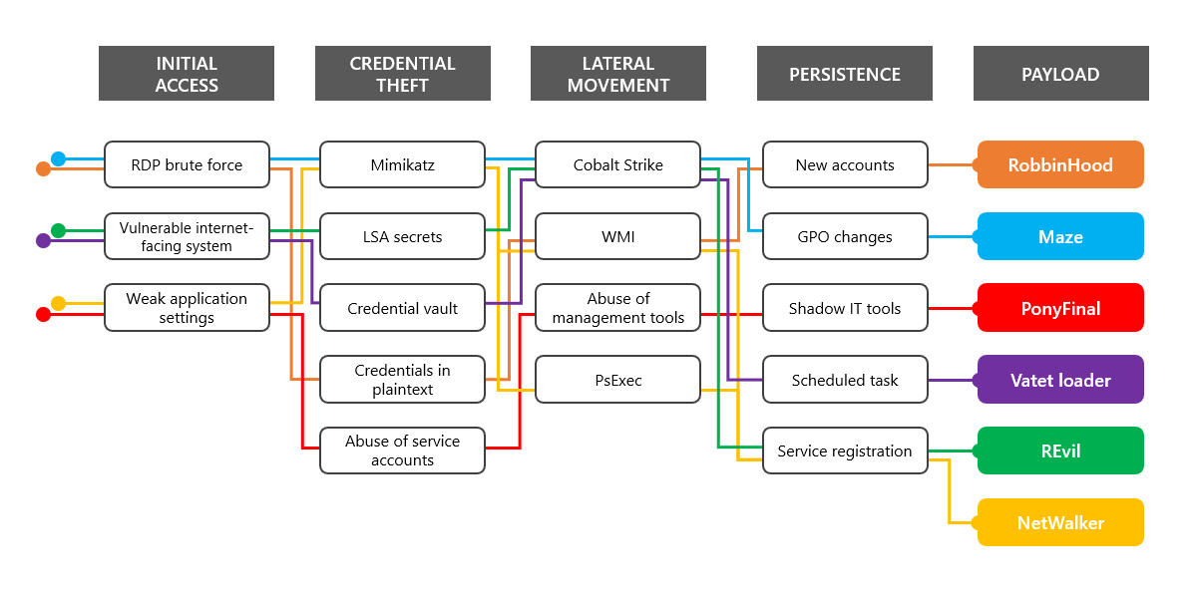
Is two factor enough? (no...)
Ransomware is ufortunately big business
65% of all ransomware attacks start via phising campaigns
Other attack vectors: Identity, Vulnerabilities, & Brute-force
Attacks happening about every 11th second
85% of all ransomware attacks are aimed against Windows enviroments
ESXi, Mac OSX, Linux
Seeing alot more vulnerabilities comparing 2019 to 2020
Ransomware 2.0 aiming more at data exfiltration 😐 😐

Slide 12
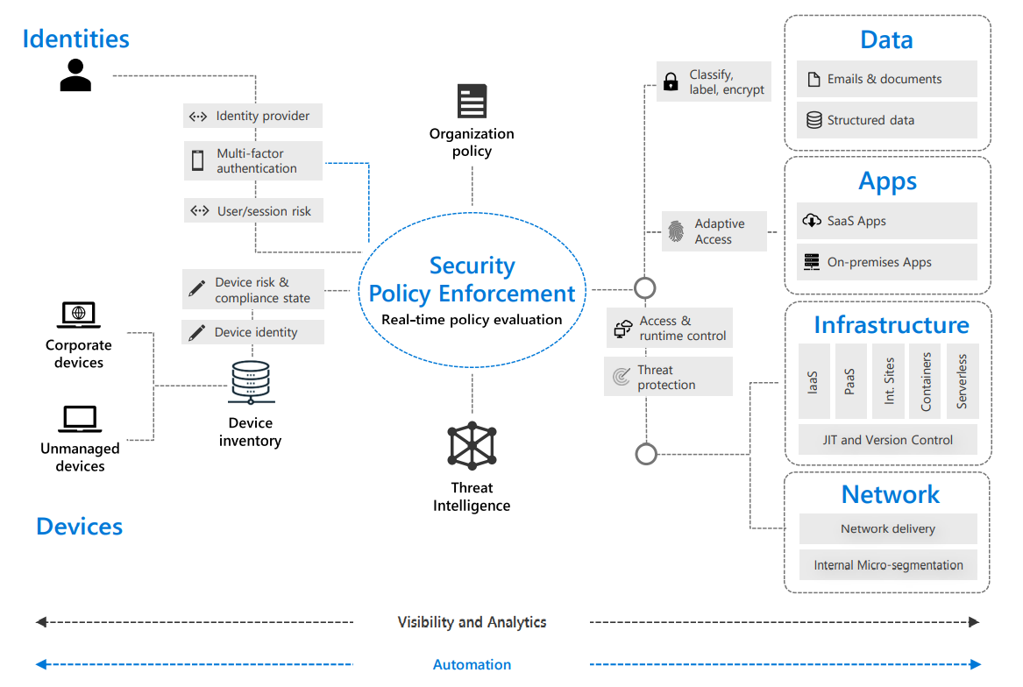
So where does Zero-Trust and SASE fit in?
Zero-Trust (Trust no one) Treat everyone as hostile
Dynamic evaluation of the risk (Not just at initial connection)
Risk often determined by (User, Device, Session, Transport)
This often requires large datasets to predict abnormal traffic patters
More Sleeping (Reading Material) → SP 800-207, Zero Trust Architecture | CSRC (nist.gov)
Every vendor “jumping onboard”

Slide 13
What About SASE?
Another hype train?
A new architectual model for future networking and security
A delivery of decentralized security services combined with cloud based services
Combining a package of technologies
SD-WAN – More Intelligent Traffic Flow
Secure Web Gateway - Web Security Mechanisms
Cloud App Security Broker – API Integerated Security to Cloud Services
Zero-Trust Network Access – Handling access to applications and services
Firewall As A Service
And more! Depending on vendor...

Slide 14
Zero-Trust solutions and services from vendors
Product | Microsoft | Citrix | VMware
Zero-Trust Network Access | Azure Active Directory Conditinal Access | Citrix Workspace | VMware Workspace One
Identity Service | Azure Active Directory | Azure Active Directory, Okta, Gateway (RADIUS), SAML, Duo | VMware Workspace One Access, RADIUS, SAML, Duo
Device Management | Endpoint Manager | Citrix Endpoint Manager | VMware UEM
EDR (Endpoint Detection and Response) | Microsoft Defender for Endpoint | N/A | Carbon Black
Secure Web Gateway | Cloud App Security / Defender ATP (Sort of...) | Citrix Secure Workspace Access | VMware Cloud Web Security (by Menlo Security)
Cloud Firewall |  | Citrix Web App Firewall Service | Vmware NSX Cloud Firewall
Remote Browser Isolation |  | Citrix Secure Browser | (By Menlo Security)
SD-WAN | N/A (Azure Virtual WAN) but only in Azure | Citrix SD-WAN | VMware SD-WAN
Cloud Access Security Broker | Cloud App Security | Built-in or Cloud App Security | (By Menlo Security)
Threat Intelligence | Microsoft Security Graph | Citrix Analytics for Security and Microsoft Security Graph | VMware Edge Network Intelligence

Slide 15
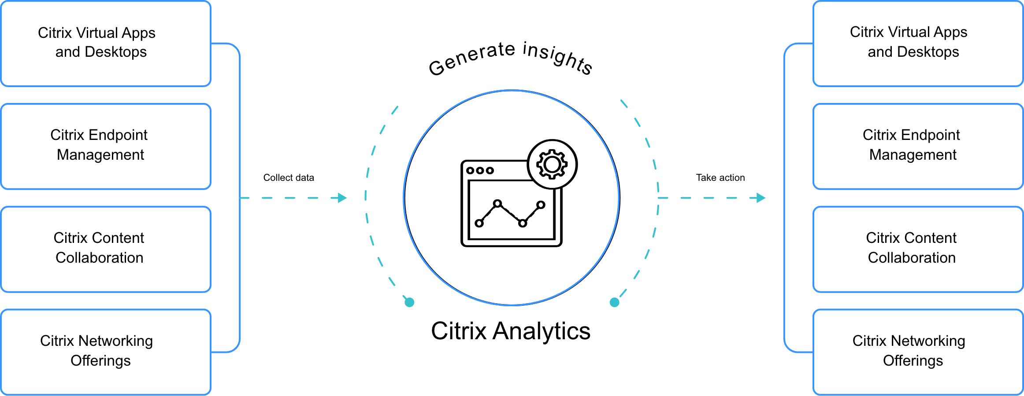
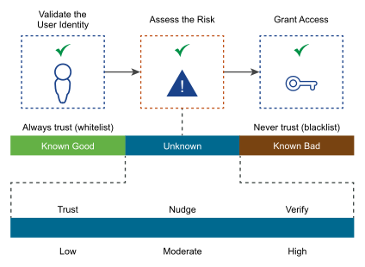
Threat Intelligence and Analytics
Citrix Analytics for Security
+ Microsoft Graph Security Risk indicators
+ Active Directory
+ Splunk
Workspace ONE Intelligence Risk Analytics
+ Carbon Black Cloud
+ VMware Threat Network

Slide 16
So much Analytics.... Across different sources
- Citrix Analytics for Performance
Data Sources:
- Citrix Virtual Apps and Desktop
- Citrix Gateway
- VMware Workspace ONE Intelligence
Digital Employee Experience Management
Data Sources:
- Windows 10 Devices
- Mobile Applications with Intelligence SDK
Data Sources (Desktop Analytics):
- Windows 7, Windows 8.1 & Windows 10
- Requires System Center Configuration Manager
- Microsoft Desktop Analytics
Workspace Analytics
Endpoint Analytics
Data Sources (Workspace Analytics):
- Office 365 or Microsoft 365 license
- Enterprise Agreement
Data Sources (Endpoint Analytics):
- Windows 10
- SCCM or Intune

Slide 17
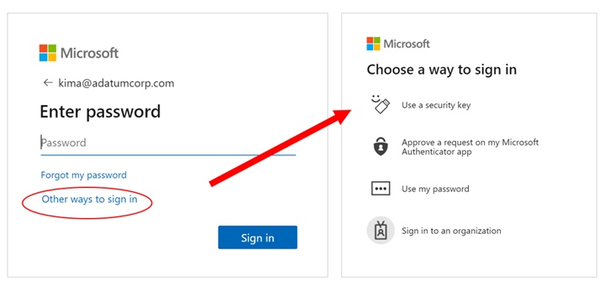
Modern Workplace and passwordless authentication
Can we get away from using passwords please?
Pretty much built-into Windows now
Now also GA within Azure Active Directory
Also supported for Hybrid Scenarioes
Windows-Integrated authentication
NTLM Authentication
IIS Authentication
Does it work with Citrix/VMware/WVD?
Citrix FAS and Azure AD
VMware Mobile SSO and or Azure AD
WVD – Almost... For web-front end but not full SSO

Slide 18
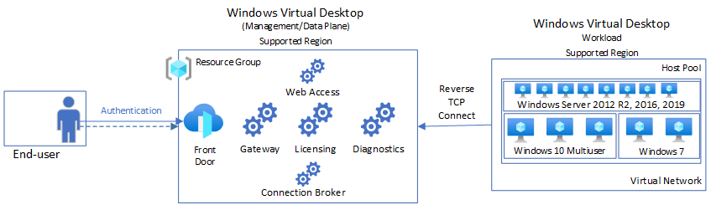
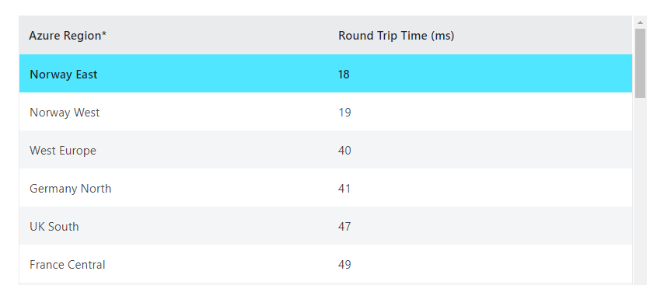
Feature updates from Microsoft/Citrix/VMware
Windows Virtual Desktop
Metadata in West Europe
RDP Shortpath
Support for Defender for Endpoint
MSIX App Attach Public Preview
Screen Capture Protection
Azure Monitor for WVD
Multiple new regions where control/data plane now placed
https://azure.microsoft.com/en-us/services/virtual-desktop/assessment/
Teams Optimized offloading using WebSocket + Zoom Support
New updates for Virtual Desktop Infrastructure (VDI) – Zoom Help Center
Start on User Connect (Coming)

Slide 19
Windows Virtual Desktop and Ecosystem
WVD can consist of many moving components
Azure AIB, Azure ARM, Azure Monitor, Azure AD
Cloud Native or rely on 3.party management to abstract away?
WVD has a big ecosystem already
Recent support by new thin client vendors
Integration ecosystem
A lot of great community offerings!
Enhanced Management Capabilities
Visio: https://bit.ly/msandbunv

Slide 20
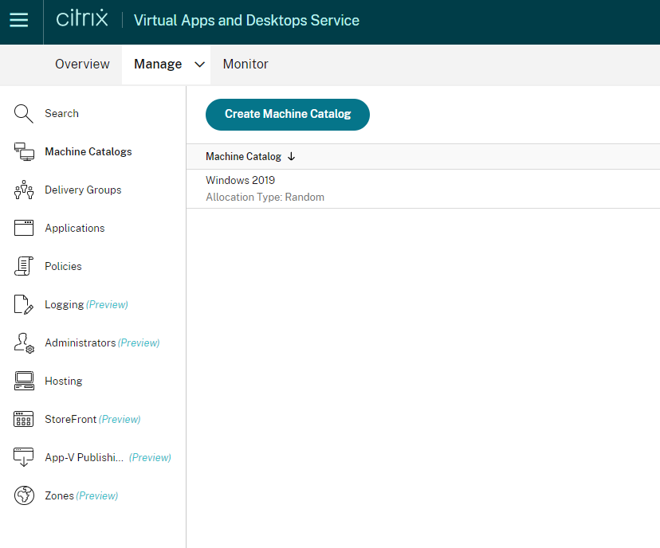
Feature updates from Microsoft/Citrix/VMware
Citrix Cloud Virtual Apps and Desktops
Service continuity for Citrix Cloud
Web Studio (Preview)
Support for storing machine images in Azure Shared Image Gallery
Rendezvous protocol
DRAG AND DROP!
Virtual Biometric Authentication
App Protection Policies
Automated Configuration Tool (Script)
Support for any SAML as Identity Provider

Slide 21
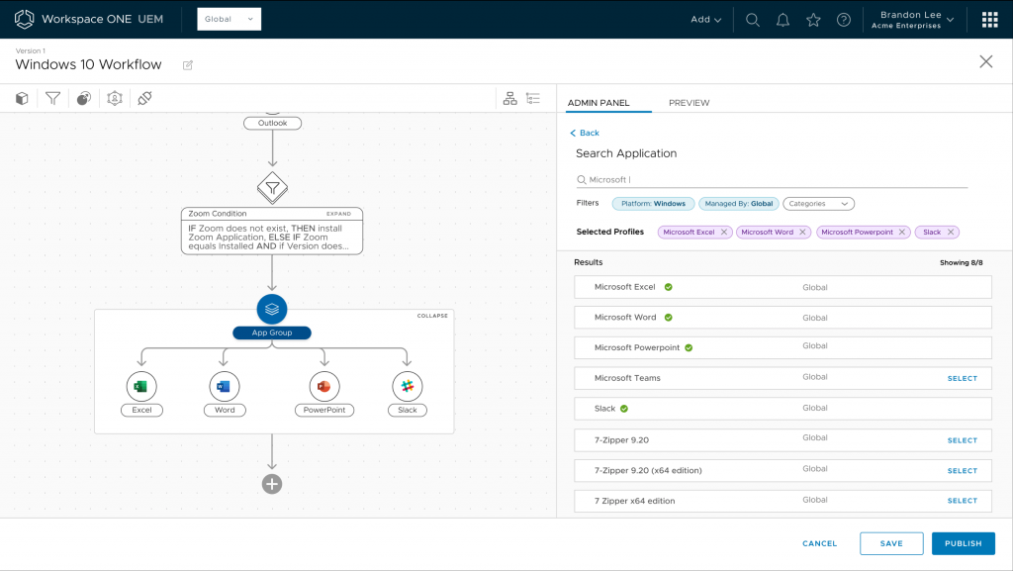
Feature updates from Microsoft/Citrix/VMware
VMware Workspace One
Tech Preview – Freestyle Orchestrator
Integrate with Azure Active Directory Conditional Access
Employee Onboarding within Intelligence Hub
In 2012 release, COPY AND PASTE!
Mobile Flow integration with new 3.party applications within Hub
App Volumes in Azure available
MSIX AppAttach management via AppVolumes
Horizon Cloud – Rolling out into new locations with control plane
So much new stuff for Horizon Cloud updates →
VMware Horizon Cloud Service Release Notes

Slide 22
So where are we at Cloud support?
Cloud | Windows Virtual Desktop | Citrix Cloud | VMware Horizon Cloud
Microsoft Azure IaaS | Yes | Yes | Yes
Google Cloud IaaS | Nope | Yes | No
Amazon Web Services IaaS | Not here either | Yes | No
Azure VMware Solutions | Don’t think so | Yes | Yes
Google Cloud VMware Engine | Hah | Yes | Yes
VMware on AWS | Not gonna happen | Yes | Yes
Azure
WVD - No builtin provisioning
Citrix & VMware has image provisoning
Google
WVD – Not supported, (works technically) but control plane in Azure
Citrix has image provisoning
AWS
WVD – Not supported, (works technically) but control plane in Azure
Citrix has image provisoning

Slide 23
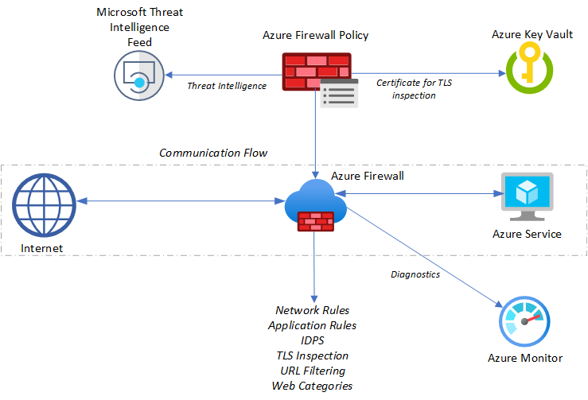
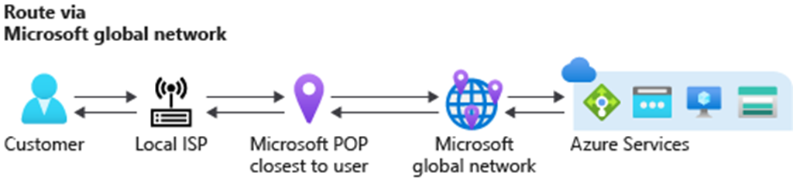
Cloud Updates
Microsoft Azure + Microsoft 365
Azure Firewall Premium – IDPS and TLS Inspection (In Preview)
Microsoft Tunnel (Seperate Slide)
Microsoft Defender for Mobile Devices (Android & iOS)
Microsoft 365 – DLP Engine for SaaS and Windows endpoints (Built on AIP)
Public Preview: Changing Performance Tier for Premium SSD Disks (without downtime)
SMB Multichannel Support for Azure Files
Azure Backup Support for Azure Files
Azure Automanage
Azure Routing Preferneces (GA yesterday)

Slide 24
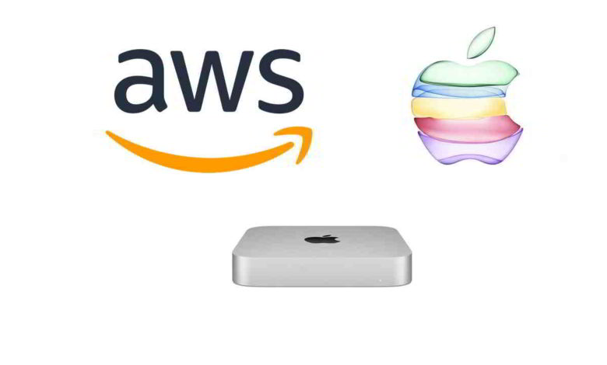
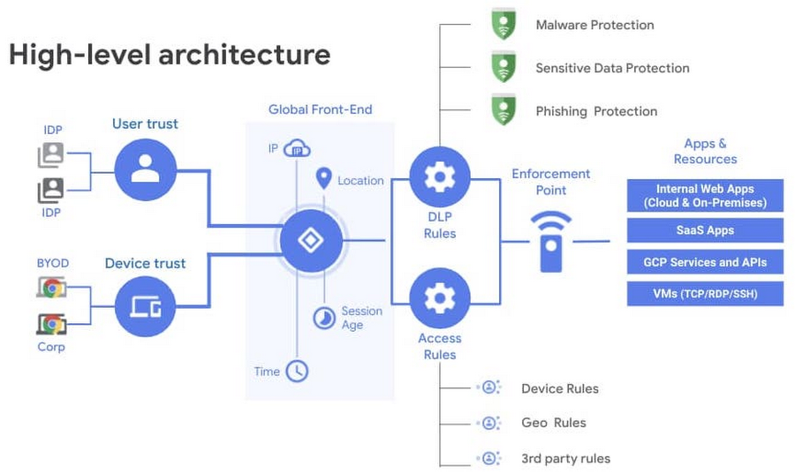
Cloud Updates
Amazon Web Services
Amazon Workspaces and new Streaming Protocol (WSP)
Aimed at users with high-latency, bad connections
In addition to PCOIP
EC2 Mac instances!
Support for Smart card authentication for Workspaces
Google Cloud Platform
BeyondCorp Enterprise
Zero-Trust based upon Chrome
Ecosystem of partners
Introduction of Google Workspace

Slide 25
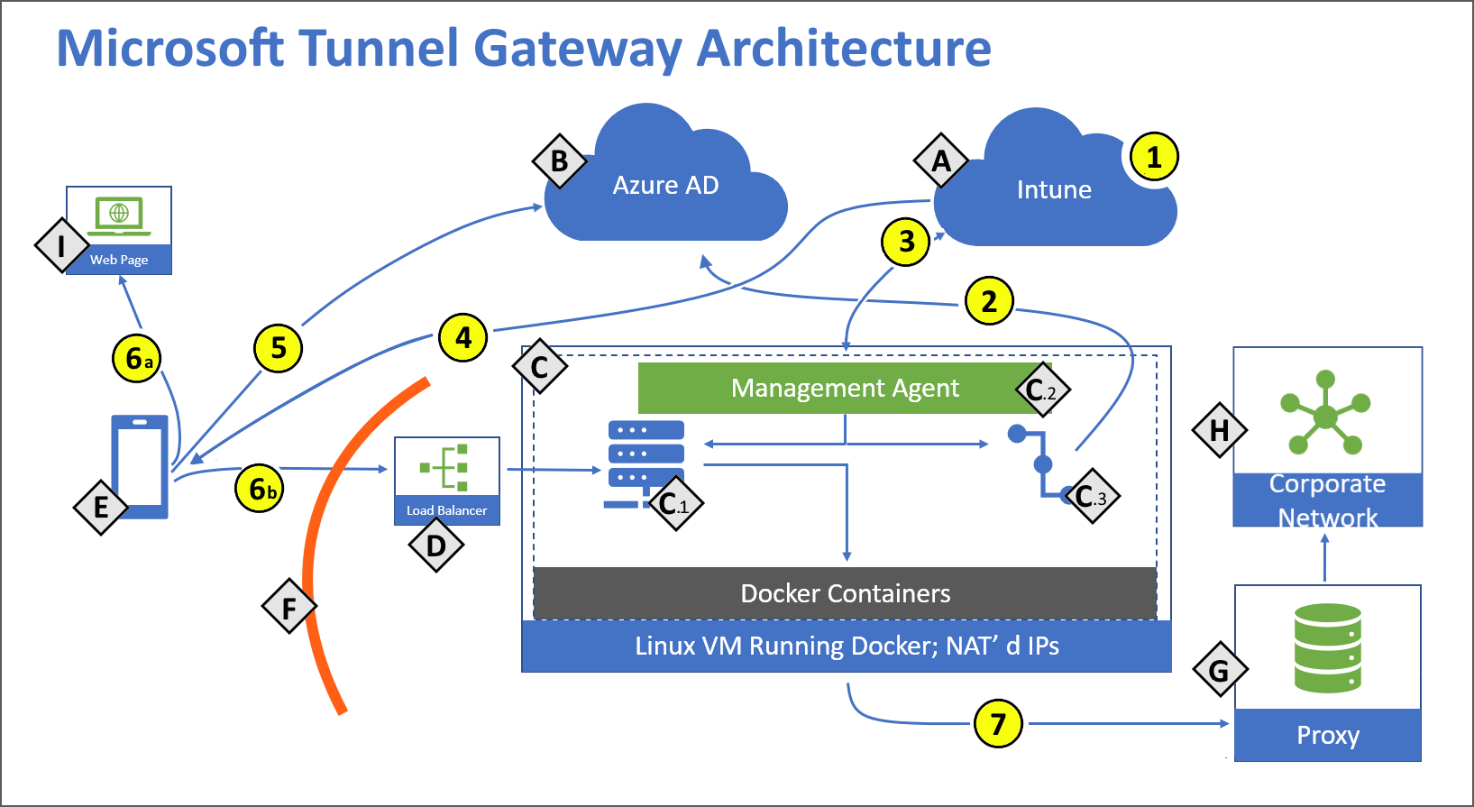
Microsoft Tunnel (Preview)
VPN Gateway Solution for Intune
Runs as Docker Container on Linux
Supported for iOS and Android
After Ignite (Integrated with Defender app)
Public Preview soon
Uses Azure AD to authenticate
Also means Conditional Access
Manual connections or or-demand
Per-App VPN or Full Tunnel
Automatically updated when new release

Slide 26
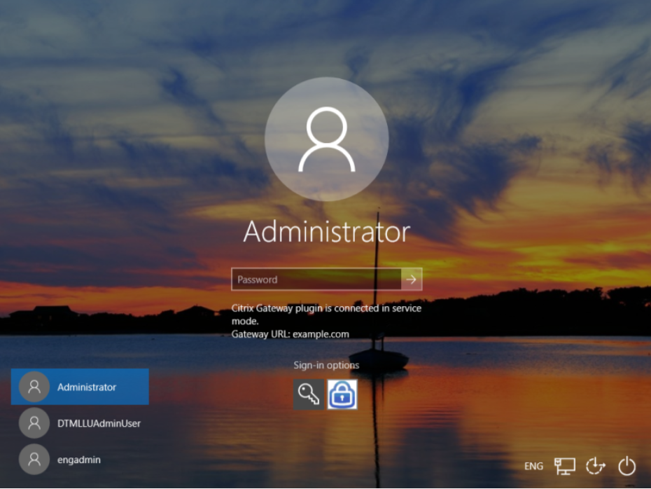
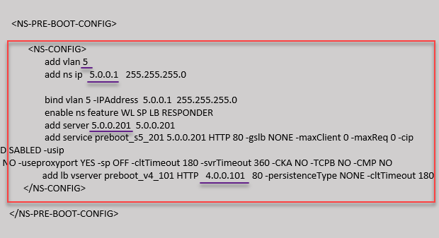
NetScaler ADC Updates
AlwaysON VPN
Citrix NetScaler ADC support with Accelerated Networking in Azure
ADC Support for Azure Stack Hub
Support for VMware ESX 7
13.0 – 76.x supports ESX 7 Update 1
nFactor authentication in Gateway support with Standard license
Rate limiting support for Citrix Gateway
AlwaysON VPN before logon for Windows
HDX EDT with Gateway Service (Tech Preview)
NetScaler ADC and support for preboot customization
EDT MTU Discovery!

Slide 27
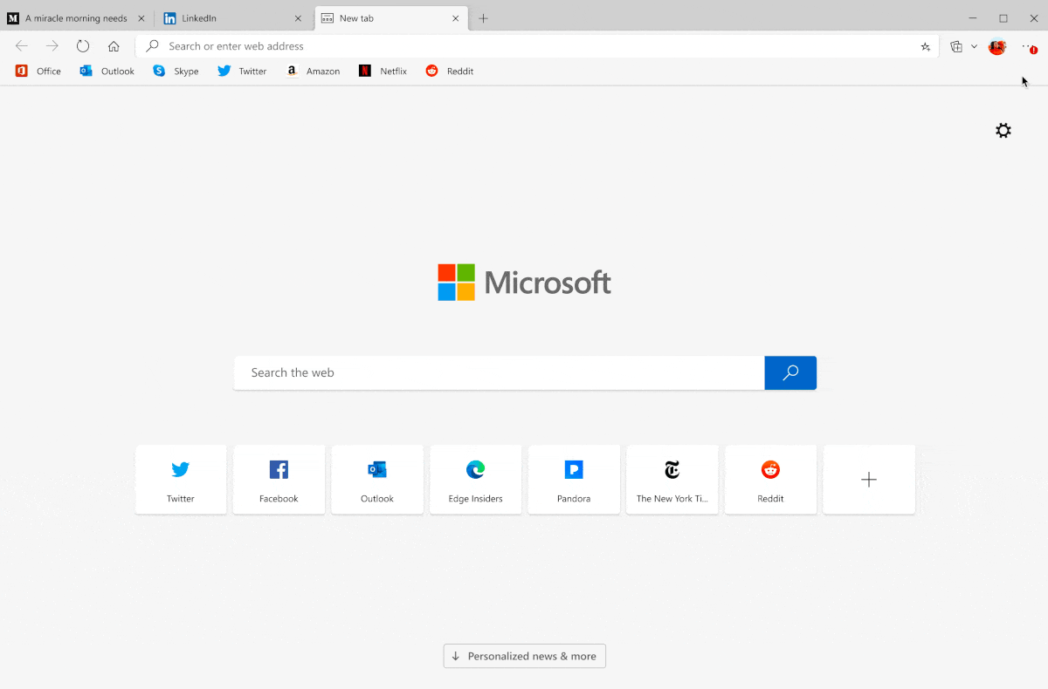
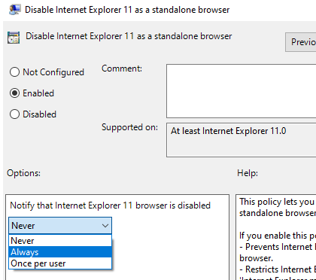
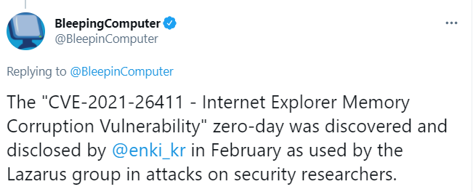
New browser updates – Yes that is important!
Password Monitor (Monitor for leaked passwords)
Sleeping Tabs (Reduce CPU/Memory of inactive tabs)
Startup Boost (launch browser in background with sign-in)
Application Guard (Start pages in isolated VM containers)
Support for DNS-over-HTTPS (configured via policy)
Security baseline for Edge/Chromium
Security baseline for Chromium-based Microsoft Edge
Disable IE 11 option now part of Group Policy ! Yay, byebye

Slide 28
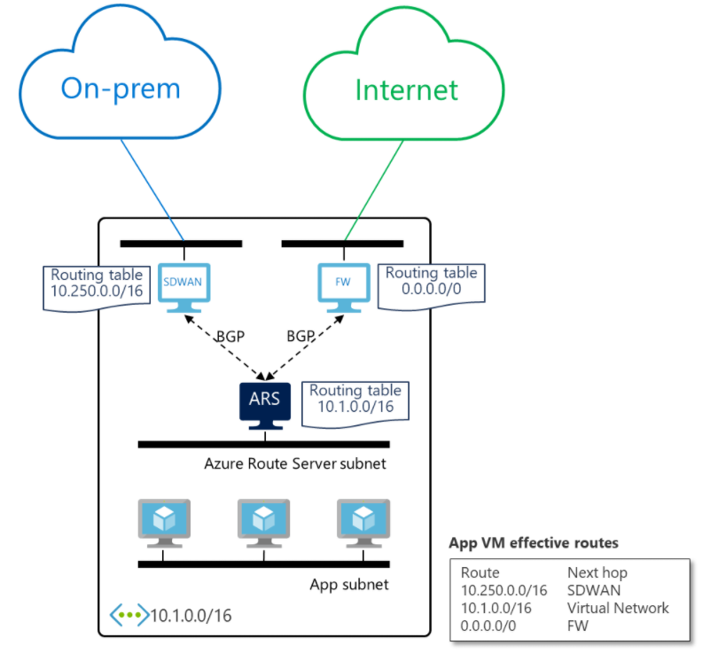
What’s new from Microsoft Ignite EUC view
Azure Resource Mover (GA)
Azure Automate RPA – Free for Windows 10
Universal Print GA
Support from Windows and from OneDrive for Business App
Attack Simulation Training
Azure Sentinel and Azure Defender integration
Azure Route Server (Preview)
Notification / Approval tasks in Microsoft Teams
Power Automate and Microsoft Teams
And some VR stuff that I didn’t quite catch up on..
All the news here → Microsoft Ignite 2021 Book of News

Slide 29
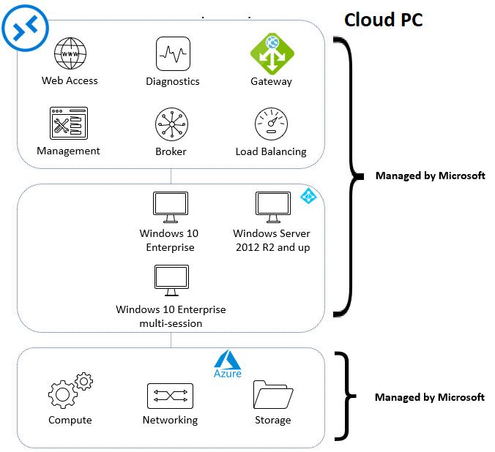
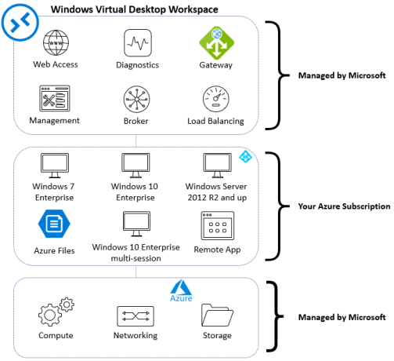
The next iteration of WVD – CloudPC?
WVD has a shared responsibility
Cloud PC might be Microsoft first Managed DaaS
Windows 10 only service
Would likely be a service offered as part of Microsoft 365
Different SKU’s
Light, Medium, High-end
We just define Windows 10 image and network connection
Gallery image or custom image
No direct statement from Microsoft yet, unconfirmed sources
Still the updated to Microsoft 365 API suggests that they are in progress
virtualEndpoint resource type - Microsoft Graph beta | Microsoft Docs

Slide 30
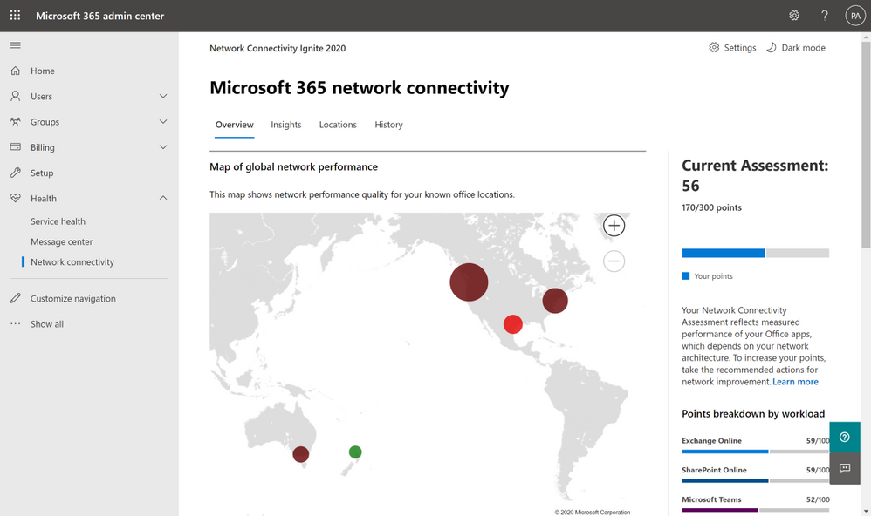
Other Windows + M365 related updates
Microsoft Teams VDI 2x2 Update (Part of Teams Preview Ring)
New Group Policy settings to exclude specific files to get synced
Microsoft 365 Multi Geo options with Satellite Zones
Network Connectivity check in Admin Center (SD-WAN)
MSIX Supports NT Services (Windows 2004)
Batch Coversion of App-V to MSIX MSIX – Batch Conversion App-V 5

Slide 31
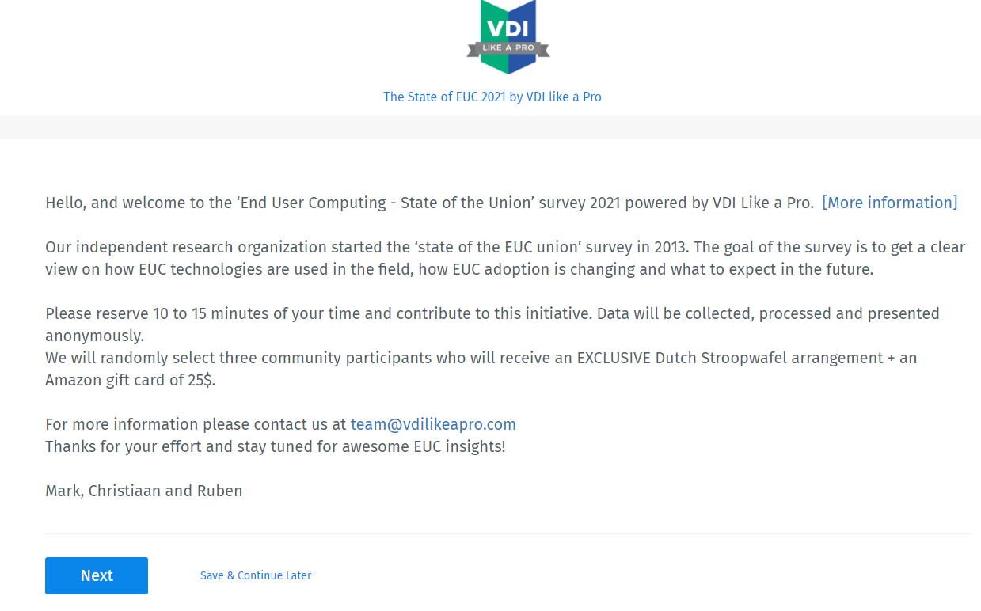

Other great community work
https://go-euc.com
vdilikeapro.com/survey2021

Slide 32
Where are we moving?
Most customers moving a cloud based ecosystem (SaaS/PaaS/IaaS)
More complex ecosystem, higher security risks
Vendors moving to a Zero-Trust based architecture
SASE part of foundation delivered as Cloud Services
Simplifying SaaS based actions with virtual assistants and workflow automation
Vendors moving further up becoming an integral part of the end-user experience not just providing apps
End-User Delivery and Security platform (EUDASP?)™

Slide 33
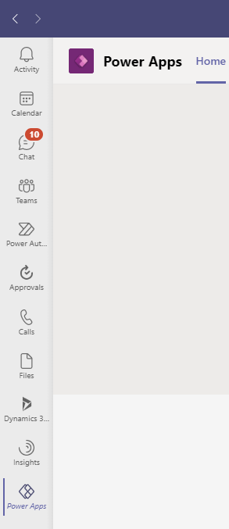
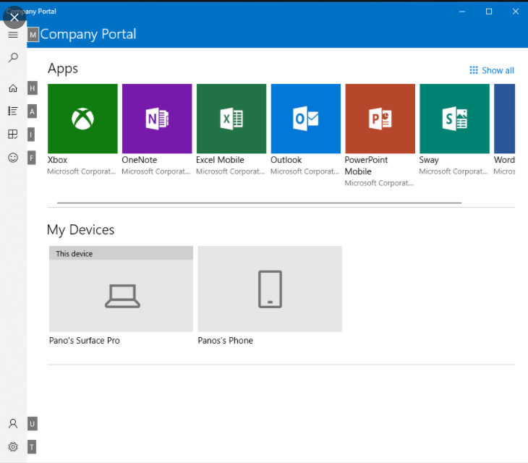
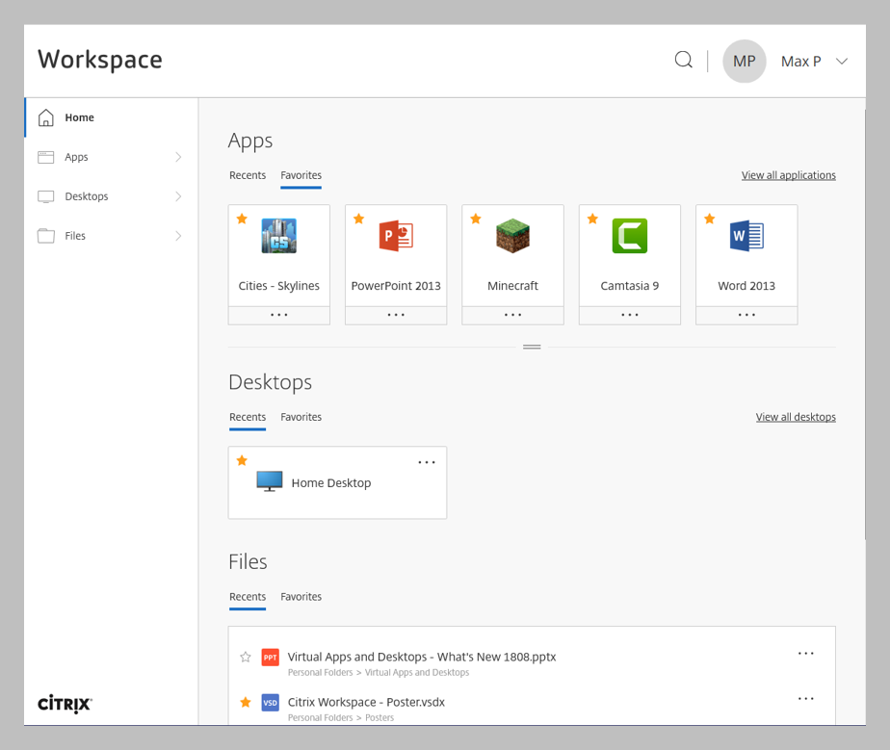
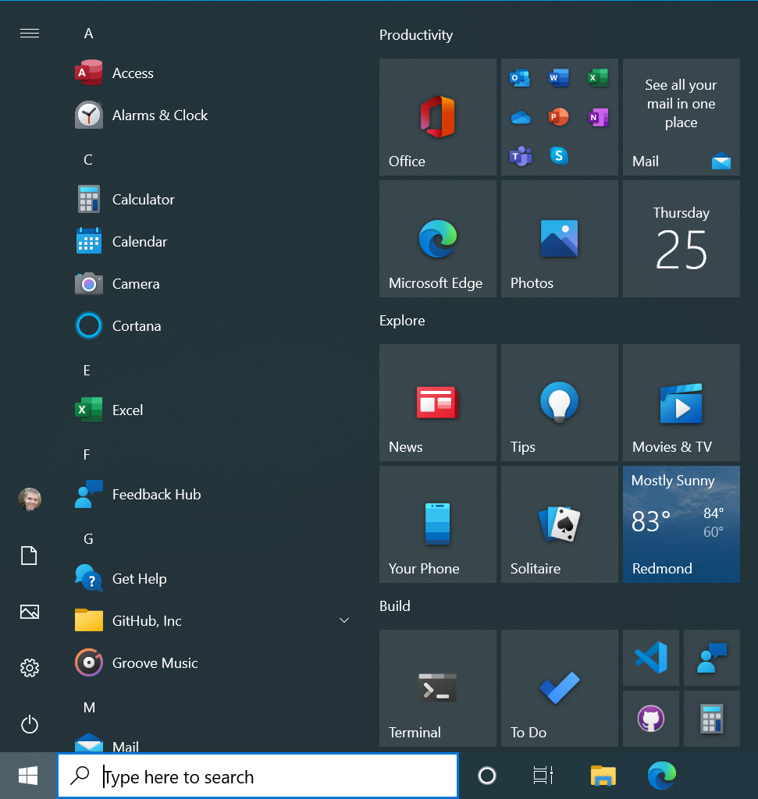
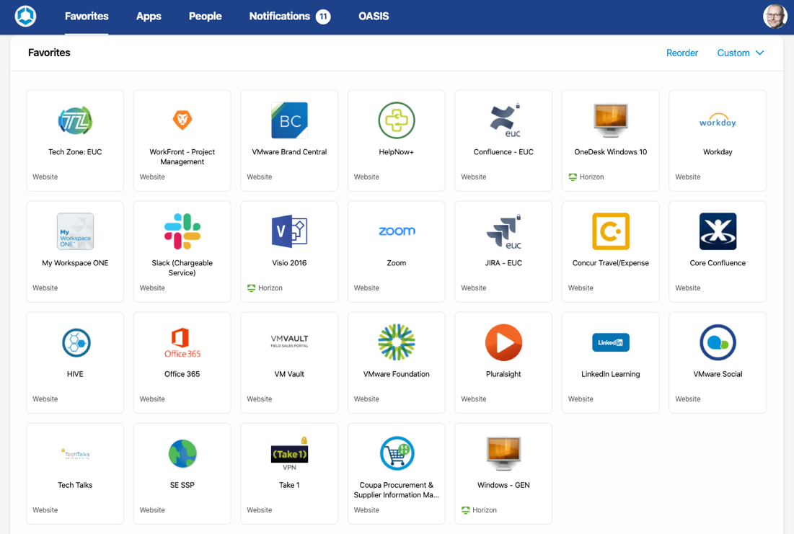
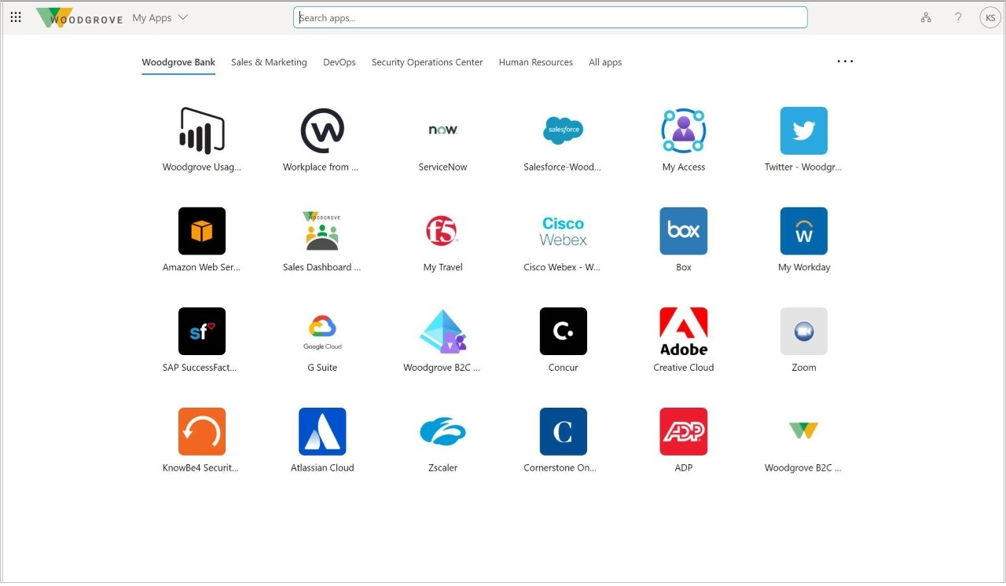
Is all this new technology making it easier?

Slide 34
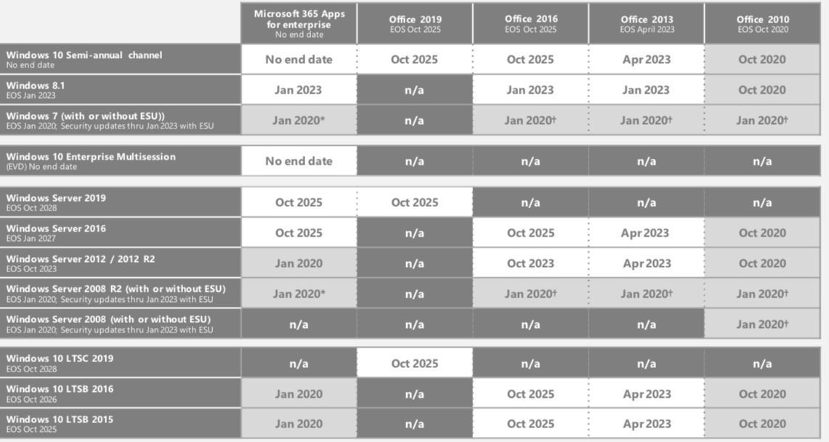
Something also to remember
https://t.co/qDkIXst3tM?amp=1

Slide 35

Other questions?
Access PPT Slides →
github.com/msandbu/mycugc
@msandbu
msandbu@gmail.com
THANK YOU!
Follow @myCUGC!
www.mycugc.org
#myCUGC

